Slide 1
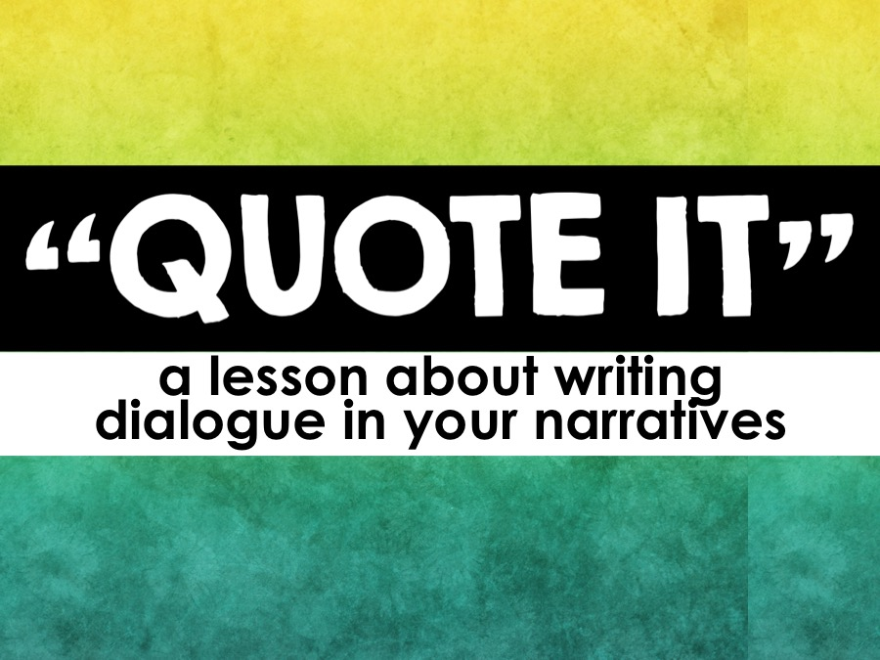

Slide 2
QUOTE IT!
“
What is dialogue?
Why use dialogue?
Dialogue rules to remember
Punctuating dialogue
Question marks and exclamation points
Dropping the tag line
Exciting dialogue
”

Slide 3
What is Dialogue?
“
Dialogue is a conversation between two or more characters in a story.
Dialogue is separated from the narration by “quotation marks.”
”

Slide 4
Why use Dialogue?
“
Dialogue helps your writing in a number of ways:
it adds variety
it adds a realistic element to the story
it helps enhance the mood
it helps enhance the characters
”

Slide 5
Terms to Know
“
Quotation mark – punctuation used to distinguish narration from dialogue
Question mark – punctuation used when asking a question
Exclamation point – Punctuation used when making an exclamation
”

Slide 6
Terms to Know
“
Period – Punctuation used to end a statement
Comma – Punctuation used to separate clauses, dialogue, or tag lines
Tag line – a phrase that shows dialogue ownership
”

Slide 7
Rules to Remember
“
Remember these rules when writing dialogue
New speaker, new paragraph – whenever the conversation switches from one person to another, you need to start a new paragraph.
Direct quotations always begin with a capital letter.
EX: He said, “See you at the tournament.”
”

Slide 8
Rules to Remember
“
Remember these rules when writing dialogue
Never close dialogue with a period UNLESS it is the end of the entire sentence.
EX: “Let’s go to the hockey game,” said Sally.
Sally said, “Let’s go to the hockey game.”
EX: “Do you want some popcorn?” asked Lennie.
Lennie asked, “Do you want some popcorn?”
EX: “Let me go!” she shouted.
She shouted, “Let me go!”
”

Slide 9
Rules to Remember
“
Remember these rules when writing dialogue
Keep it simple – you want your audience to be able to easily follow the conversation and know which character is speaking.
Write a realistic conversation – the conversation needs to be believable.
Avoid saying “said” too many times.
”

Slide 10
Dialogue Should…
“
Reveal characters’ relationships with one another
Reveal the characters’ thoughts and wishes
Help develop the characters (indirect characterization)
Move the plot forward
Increase the suspense
Be realistic and believable
”

Slide 11
“
PUNCTUATE IT!
Punctuating your
dialogue correctly
”

Slide 12
Punctuate it!
“
There are several ways to include and punctuate dialogue:
Dialogue followed by the tag line
Tag line followed by the dialogue
Tag line interrupting the dialogue
”

Slide 13
Punctuate it!
“
“I want to get some ice cream,” Mary said.
The sentence ends with proper punctuation.
Quotation marks go around all of the words that the character says.
A comma is placed before the quotation mark to separate the dialogue from the tag line.
The tag line provides ownership for who said the quote.
”

Slide 14
Punctuate it!
“
Mary said, “I want to get some ice cream.”
The tag line provides ownership for who said the quote.
Quotation marks go around all of the words that the character says.
The sentence ends with proper punctuation.
A comma is placed before the quotation mark to separate the dialogue from the tag line.
”

Slide 15
Punctuate it!
“
“Well,” said Mary. “I want ice cream.”
Quotation marks go around all of the words the character says, even if the dialogue is interrupted by the tag line.
Commas separate dialogue from the tag line.
The sentence ends with proper punctuation.
The tag line provides ownership for who said the quote. It can interrupt the dialogue.
”

Slide 16
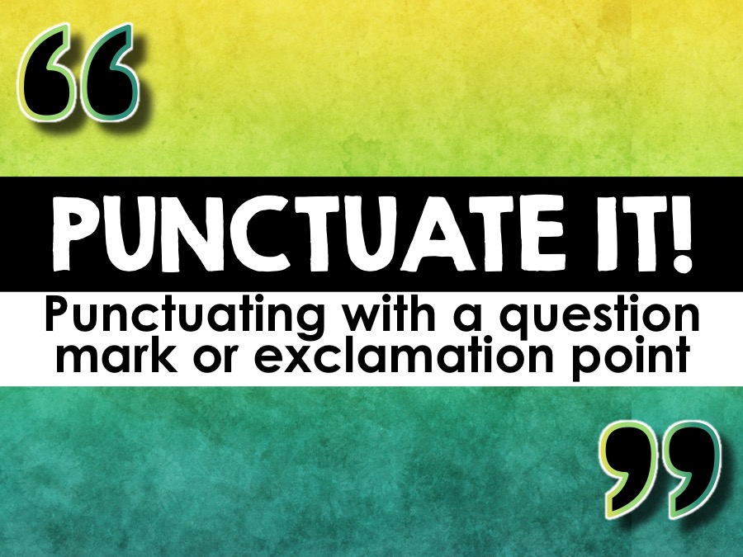

Slide 17
Punctuate it!
?
Place the exclamation point or question mark inside the quotation marks when they punctuate the quotation.
Place them outside when they punctuate the main sentence.
EXAMPLE:
I was a little mad when she asked, “Hey! Can I borrow your new skirt?”
Did she really just say, “Finish by tomorrow”?
!

Slide 18
Punctuate it!
?
When using exclamation points and question marks in your dialogue, properly punctuate the tag line.
If the sentence continues and the following words are not proper nouns, DO NOT capitalize the next word.
!

Slide 19
Punctuate it!
?
EXAMPLE:
“Did you want to get ice cream?” asked Isabel.
“Look out!” warned John.
“Get down from there!” Mr. Jones exclaimed.
!

Slide 20
Dropping tag lines
If only two characters are engaged in a dialogue, you can drop your tag lines to help clean up the conversation.
This will allow your audience to focus on the exchange between characters.
REMEMBER: You must write a new paragraph every time the speakers switch!

Slide 21
Dropping taglines
With taglines
Without taglines
“Want to sit outside today?” Anna asked.
“Sure,” Jen replied. “It’s a nice day today. Hey, how did you do on that biology test?”
“I think I did okay,” replied Anna.
“I don’t think I did so well,” said Jen.
Anna commented, “I think we find out our scores on Thursday.”
“Want to sit outside today?” Anna asked.
“Sure,” Jen replied. “It’s a nice day today. Hey, how did you do on that biology test?”
“I think I did okay.”
“I don’t think I did so well.”
“I think we find out our scores on Thursday.”

Slide 22
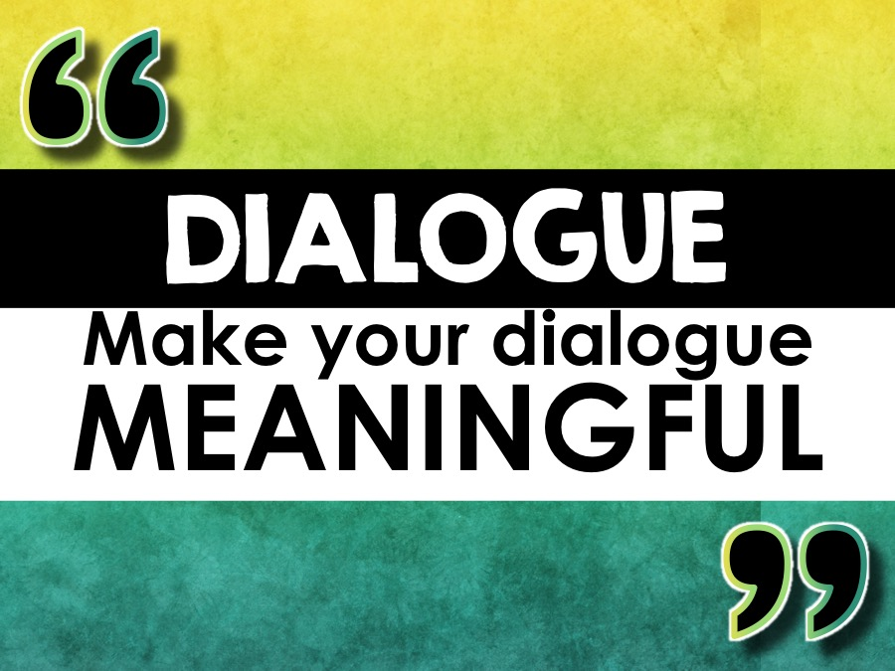

Slide 23
Meaningful Dialogue
“
You want your dialogue to be meaningful and exciting.
If you can easily paraphrase the conversation or write it as narration, it is best to do so.
”

Slide 24
Meaningful Dialogue
“
This conversation is DULL!
“Hi,” she said.
“Hi,” he replied.
“How are you?” she asked.
“I’m okay,” he replied. “How are you?”
”

Slide 25
Meaningful Dialogue
“
It can be rewritten very simply.
The boy and girl said hello to each other and asked how the other one was doing.
Avoid simple and boring dialogue in your writing.
”

Slide 26
Meaningful Dialogue
“
This conversation is EXCITING!
“Hey!” the captain shouted, “look over there.”
“I don’t see anything. It’s too dark, and I’ve got a bad feeling about this,” the first mate replied.
“How can you not see it?” the captain asked. “It looks like there is a spaceship flying over the ocean!”
”

